Slide 1

TOPIC MODELING & SENTIMENT ANALYSIS
Airbnb Reviews

Slide 2
Objectives Workflow dataset Tools
TABLE OF CONTENTS
Data preprocessing Topic Modeling Sentiment analysis Future work

Slide 3

OBJECTIVE
Topic modeling with reviews will help Airbnb to improve customer experience
Applying sentiment analysis to differentiate between negative, neutral, and positive reviews.

Slide 4
WORKFLOW
FROM START TO FINISH
Raw Data
Data Preprocessing
Topic Modeling
Sentiment Analysis
from inside Airbnb
preprocessing the raw data
NMF, LSA, LDA, and CoreX
Negative, positive, and neutral reviews

Slide 5
ABOUT OUR DATASET
From inside Airbnb
80k+ review
6 columns

Slide 6
Tools
Pandas
Numpy
Matplotlib
NLTK
pickle
Seaborn
Wordcloud

Slide 7


Data Preprocessing
REMOVE NON-ENGLISH WORDS
REMOVE NUMBERS, CAPTIAL
LETTERS, PUNCTUATION, AND SPELL CHECKING
REMOVING STOP WORDS
TOKENIZING AND LEMMATIZING

Slide 8
Topic Modeling
Using Count Victorizer & TF-IDF Victorizer
NMF
LSA
LDA
CoreX
3 Topics
Not good
3 Topics
Our model 4 Topics

Slide 9

CoreX
BEST MODEL
ROOMS
Kitchen, bed, bathroom, window
LOCATION
distance, market, downtown, shop
HOST COMMUNICATIONS
friendly, generous, considrate, host
CLEANLINESS
clean, bright, organize, tidy

Slide 10
SENTIMENT ANALYSIS
USING VADER
97.1%
2.6%
0.3%

Slide 11
FUTURE WORK
Scrapping the reviews from Airbnb
to get good result with the sentiment analysis
topic modeling on positive and negative reviews
to detect what are the topics that occur the most on positive and negative reviews
Build a recommendation system
to help Airbnb find listings that have similar reviews

Slide 12
THANK YOU!

Slide 13
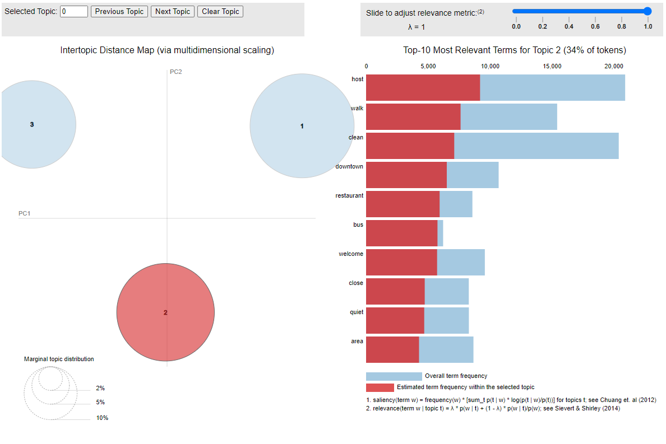
APPENDIX
LDA WITH 3 TOPICS

